Slide 1
When We Stopped
Playing Outside
j0hnnyxm4s

Slide 2
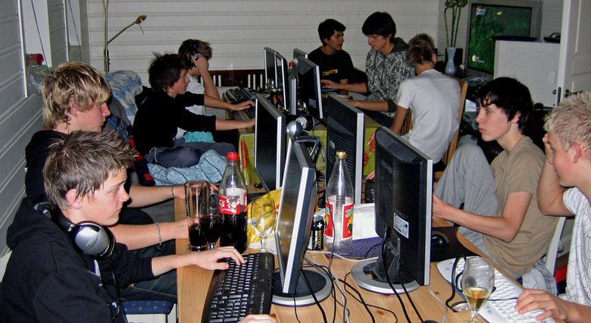

Slide 3
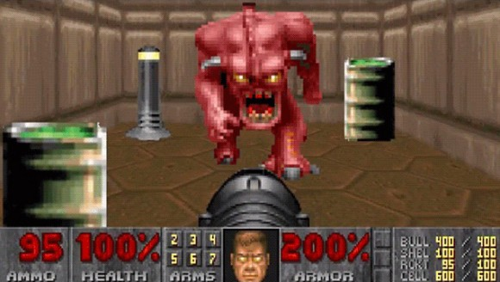

Slide 4
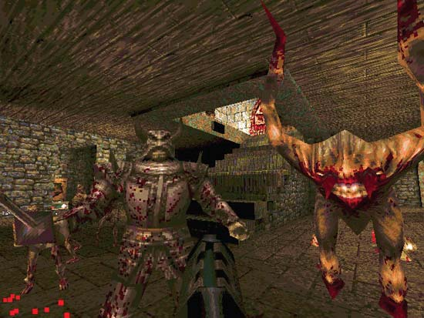

Slide 5
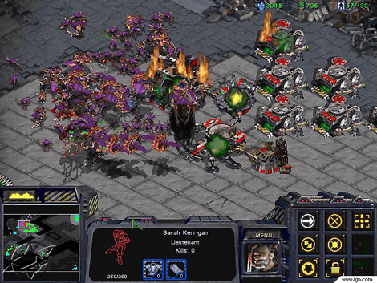

Slide 6
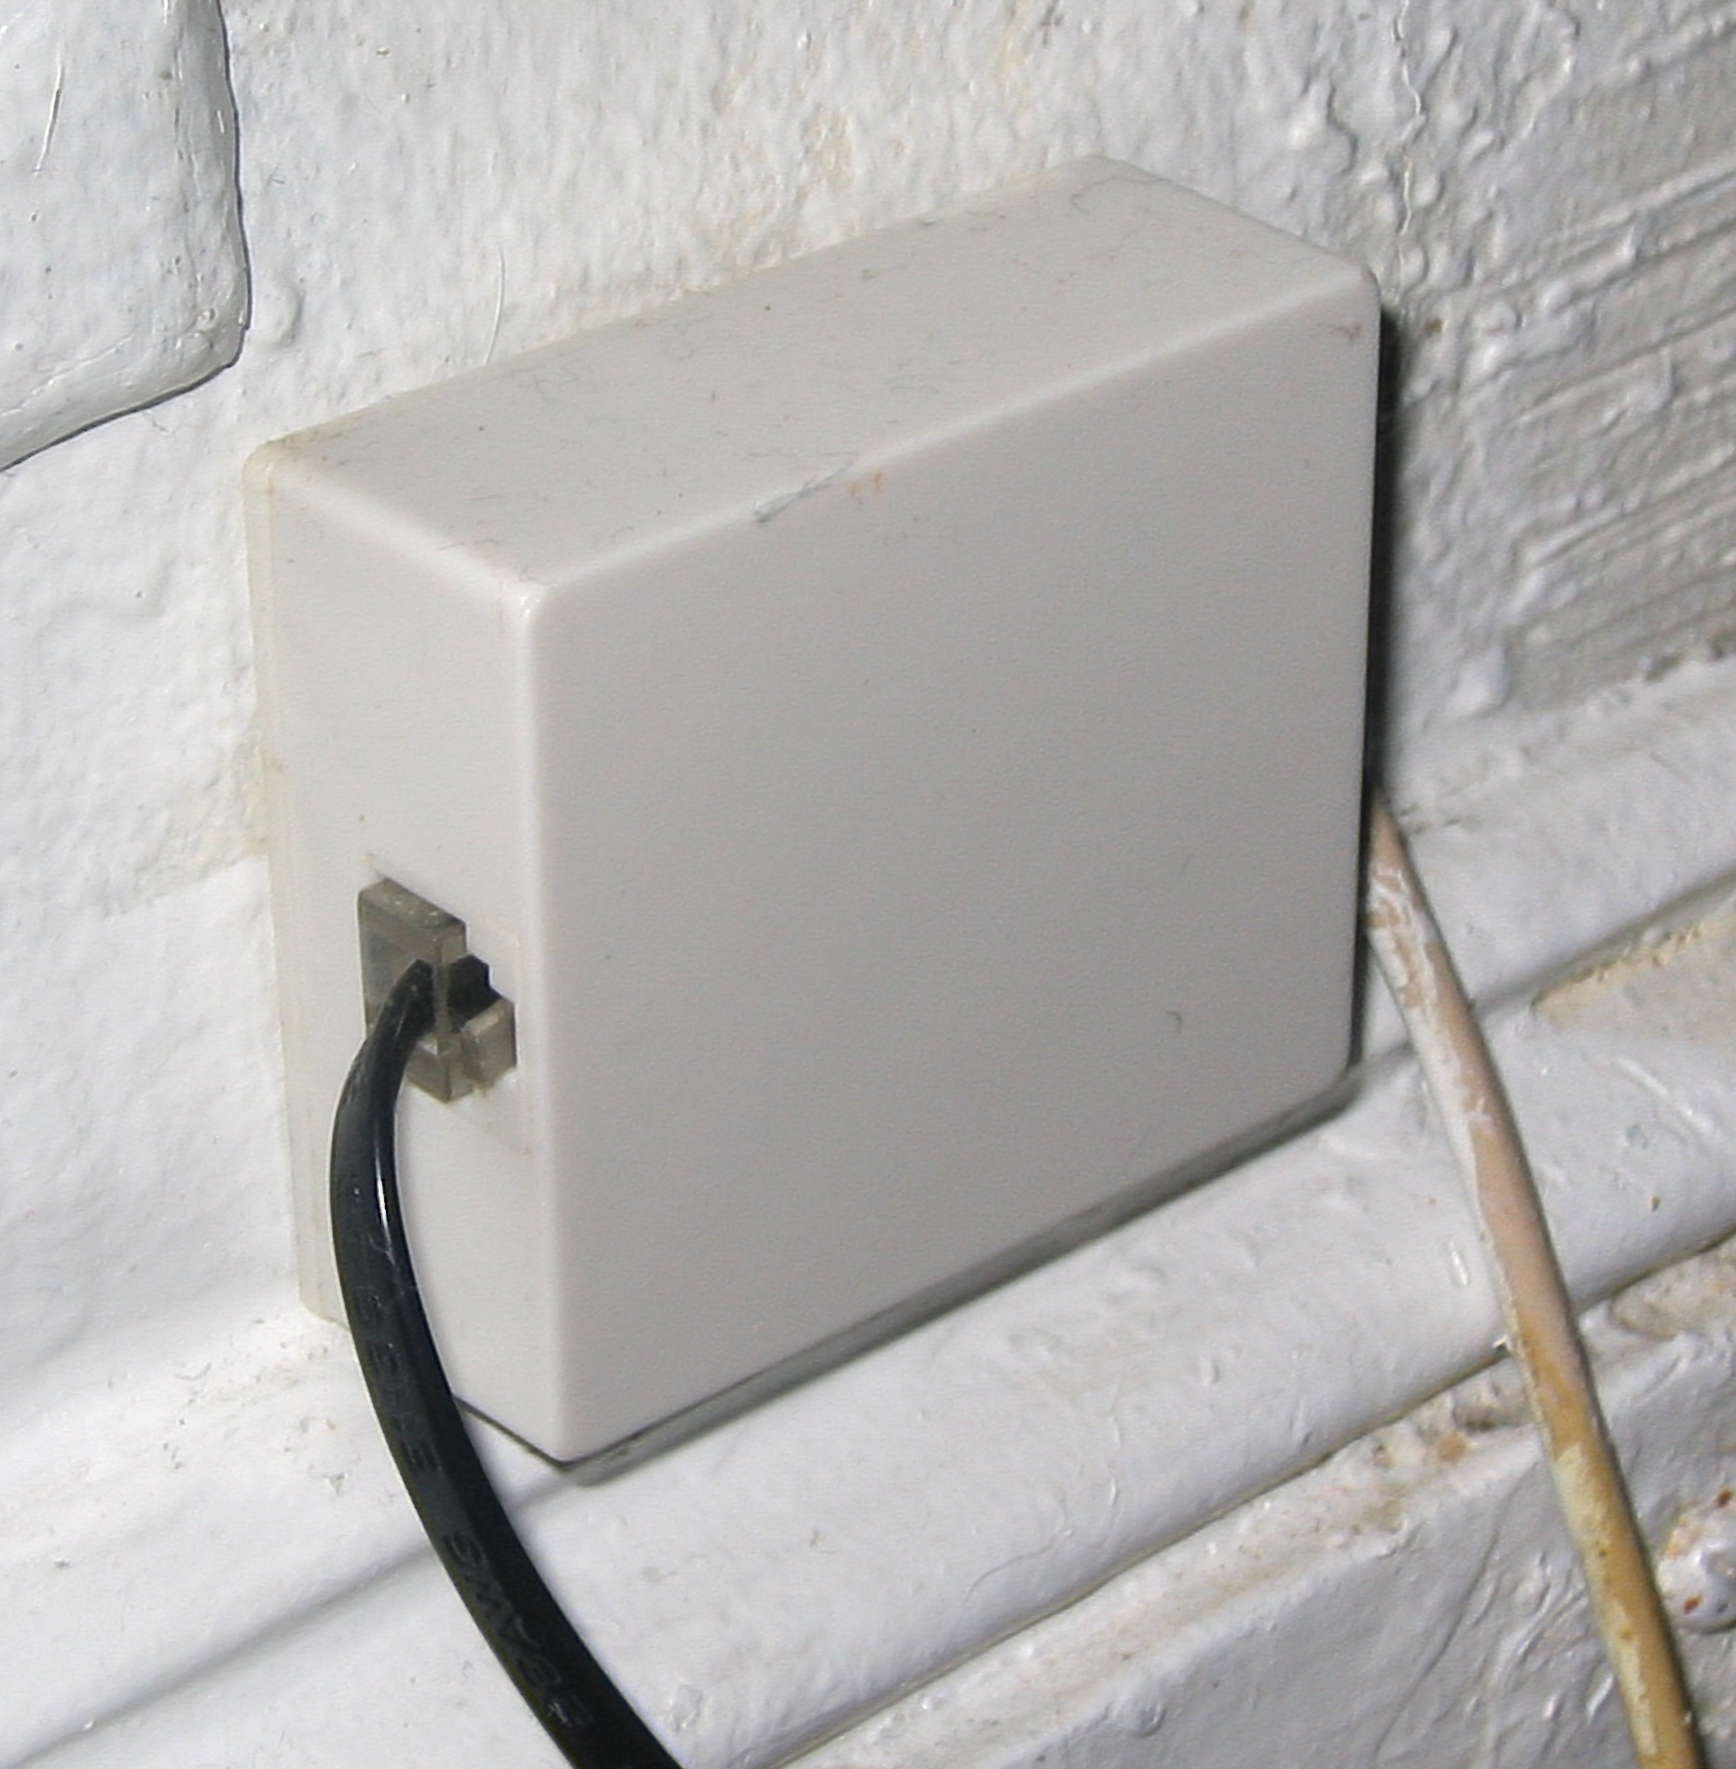

Slide 7
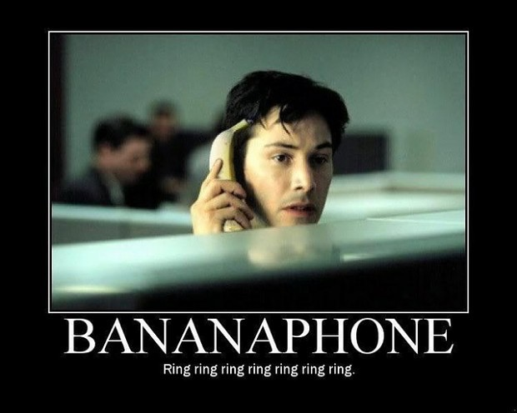

Slide 8
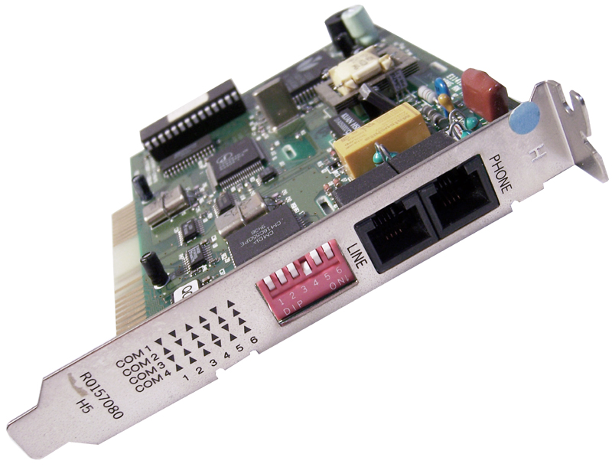


Slide 9
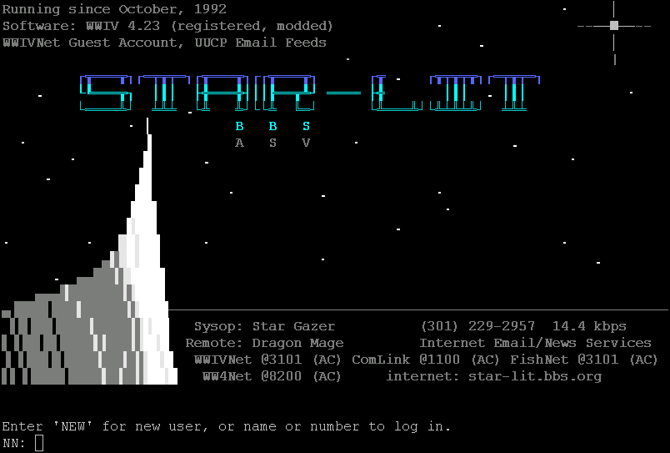

Slide 10
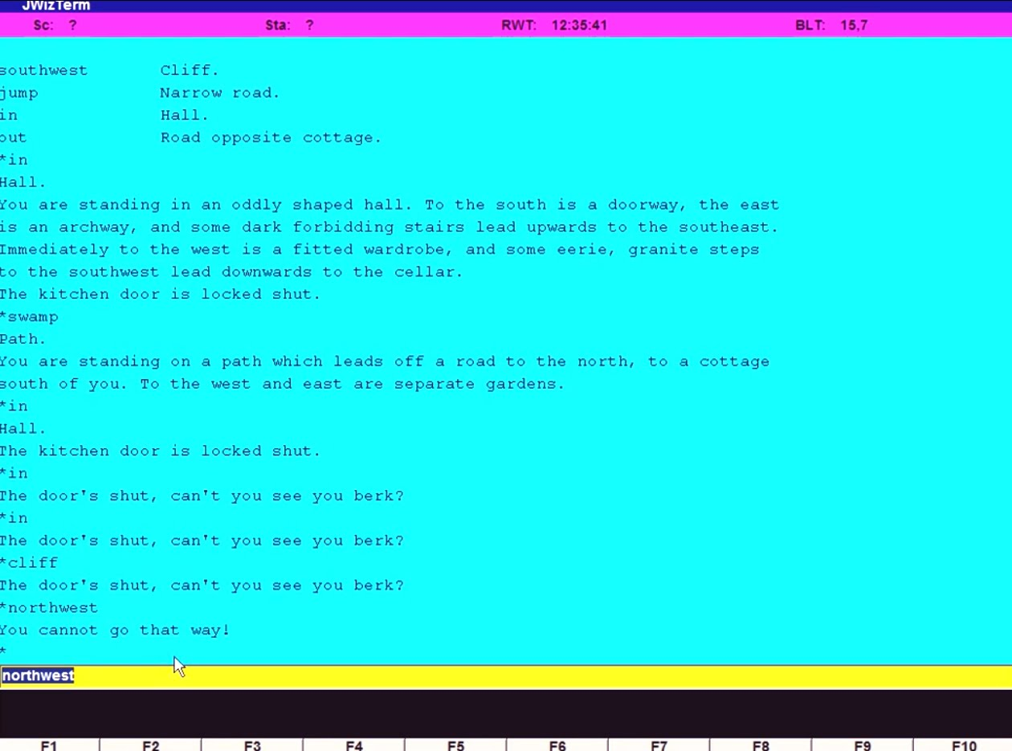
Notes:
MUD – Multi User Dungeon – British Legends

Slide 11
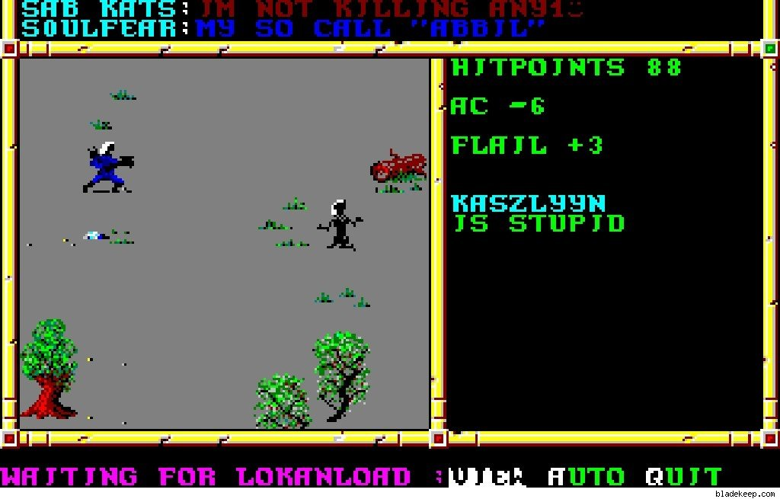
Notes:
Neverwinter Nights GO BACK TO QUAKE AND STARCRAFT!!!!!!!!!!!

Slide 12
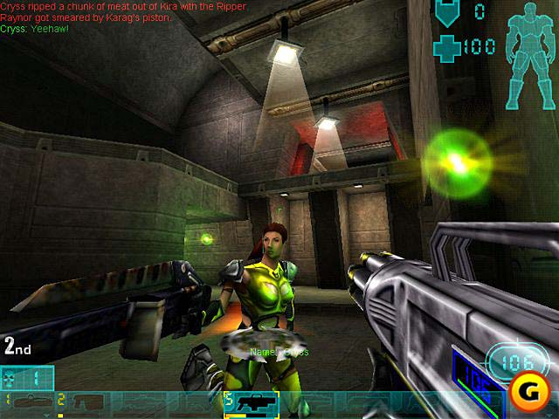
Notes:
Unreal Deathmatch

Slide 13
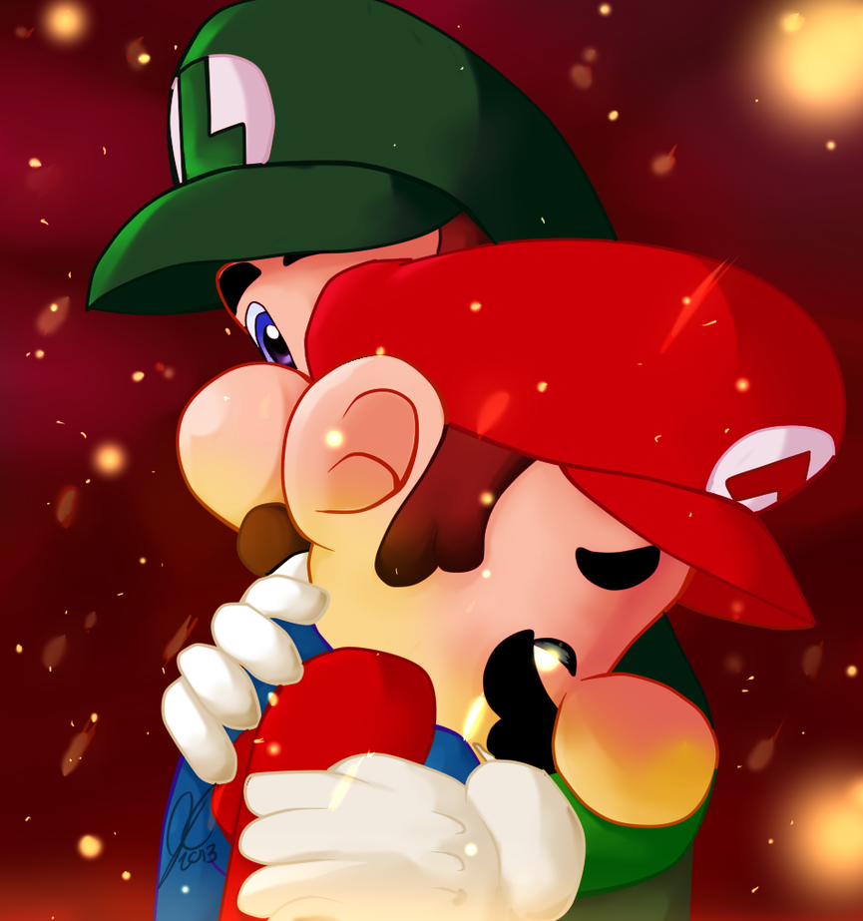

Slide 14
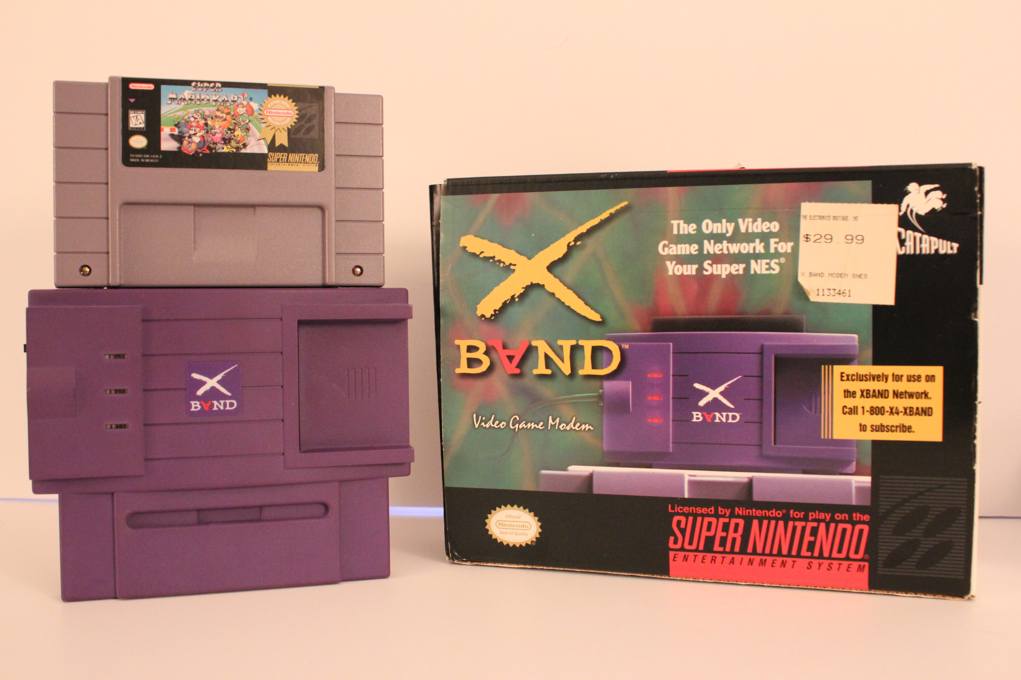
Notes:
Verbal Communications
We actually used phones to make calls!
Everyone had a public phone book (Yellow Pages), a household one, and a personal one
You had many, many numbers memorized
Pay Phones
You kept quarters around
Calling parents at work from school when you were sick
Scamming the collect call system to get a ride home after practice - Customer owned customer operated telephones (COCOTS) - Call 800 number.. get hungup on.. keep the line open and you get a new unguarded dialtone...
Anonymous
Calling payphones (Mojave phone booth, Pete & Pete) (Pay phone at Grand Central station, Time square, Disney world/land)
Landlines were shared by a household
This meant going through multiple people before getting to whom you wanted to speak with
This includes that girl from Gym Class whose number you got from a friend. (Nonconsensual phone number exchanges were commonplace in a pre-privacy society)
Prank phone calls were quite prevalent pre-CallerID
Notable prank call bootlegs tapes / simpsons prank calls
NOT PRANK>> What if nobody answered?
This whole modern concept of people getting mad if you turn your phone off because “WHAT IF IT WAS AN EMERGENCY” is bizarre. In an emergency, you called 911. Anything not 911-worthy was/is not an emergency.
We had answering machines.
Your answering machine OGM was what defined you as a person.
You went on with your life, and it was OK.
Pagers
Expensive, but everyone knew someone who had one (usually drug dealers)
Collect paging
Text paging (predecessor to texting)
If you were not near a phone (i.e. outside, at school, at work)
You didn’t spend all day talking / texting / Facebooking bullshit to everyone you know. You’d go the whole day not knowing that Frank has a cold sore. Sometimes 3 if it was a Friday.
You just walked to someone’s house to see if they were around
Sometimes they were grounded, and their mom would yell at you like you were trouble, too.
Getting a potential SO’s address was more coveted than a phone#, and stalking their house was generally socially acceptable
Having friends in another town (beyond walking distance) was considered fancy, and you often had to provide proof of their existence
Lack of Internet \ mobile communication device
You Kept some sort of personal planner, even when you were 15. You never missed an appointment. You made sure you got everywhere 15 minutes early because you had no idea what traffic would be like.
Sometimes people were late due to traffic \ unforeseen circumstances, and you just waited for them, not knowing what happened.
Road Trips:
You had a road atlas or glove box maps you used to actually plot a course that you wrote down.
Later on you had MapQuest, but you still had to print them (no GPS), and if you got lost you were hosed.
Music:
You bought entire albums, and gave them a good hard listen, because you spent a lot of money on them.
Columbia House \ Mail-Order music services
Scamming Columbia House
You had on average 12 CDs in your car, and that’s what you listen to, over and over.
You’d listen to the entire album front-to-back, sometimes repeating your favorite songs 3-4 times in a row.
You’d trade CDs with friends
Scratches \ Polishing
Buying event tickets meant going to the store and waiting in line, hoping they weren’t sold out by the time you got to the front. For popular events, you’d get there hours or days early.
You went to the library and photocopied pages out of books \ encyclopedias to do reports for school
Newspapers often came out 3x a day, with additional info on unfolding stories.
You went places (houses, parties, Denny’s) just to see who was there. There was almost always someone, and if there wasn’t you were just the first and you waited.
Rally points at large events like festivals
Debates over facts often lasted hours, as nobody could just check on their phones. Incredibly complex logical and philosophical webs would be spun to try and remember who the singer of Limp Bizkit was.
Six Degrees of Kevin Bacon was incredibly easy to SE, given that nobody could fact check.
We played board games. A LOT of board games. Lengthy, complex board games.
We talked to each other. For hours. Nobody was buried in their phone. We built friendships that no amount of arguing and backstabbing could destroy. I still know and love a lot of worthless idiots.
Ecommerce didn’t exist yet - You had to “Mail Order"
As Seen on TV!
X Easy Payments of $19.95
Check, Money order or "Cash on Delivery"
6-8 Weeks for Delivery
For TV, you watched what was on at the time, because you had no choice. If there was “nothing on,” you turned it off and maybe even went outside. This also meant sitting through all of the commercials.
Sometimes mom would come home on Friday with videos rented from Blockbuster, many of which were your favorites, and it was like Christmas. You didn’t own them because your parents didn’t want you staring at the TV all day and night.
Dial-up Internet \ PPP (Time-permitting)
Spelunking the BBS System
CompuServe \ Prodigy \ AOL \ Netzero
Associated \ Unexpected Costs
Hacking NetZero
Hacking AOL and the birth of Skiddies
P2P filesharing before torrents, Kazaa or Napster
Multiplayer remote games pre-Battle.Net
Blizzard - Warcraft \ Starcraft
Doom - The worst FPS multiplayer experience imaginable, AND IT WAS AMAZING
XBAND - The Godfather of 3rd-party online gaming framework?
Taking your computer down for hardware changes meant you had no other device to troubleshoot via the Internet with

Slide 15
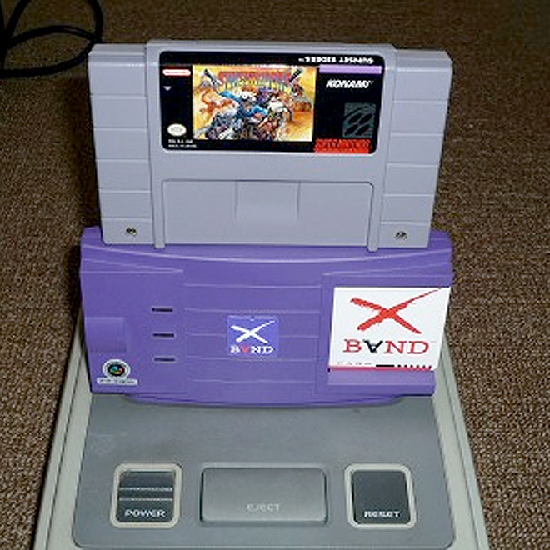

Slide 16
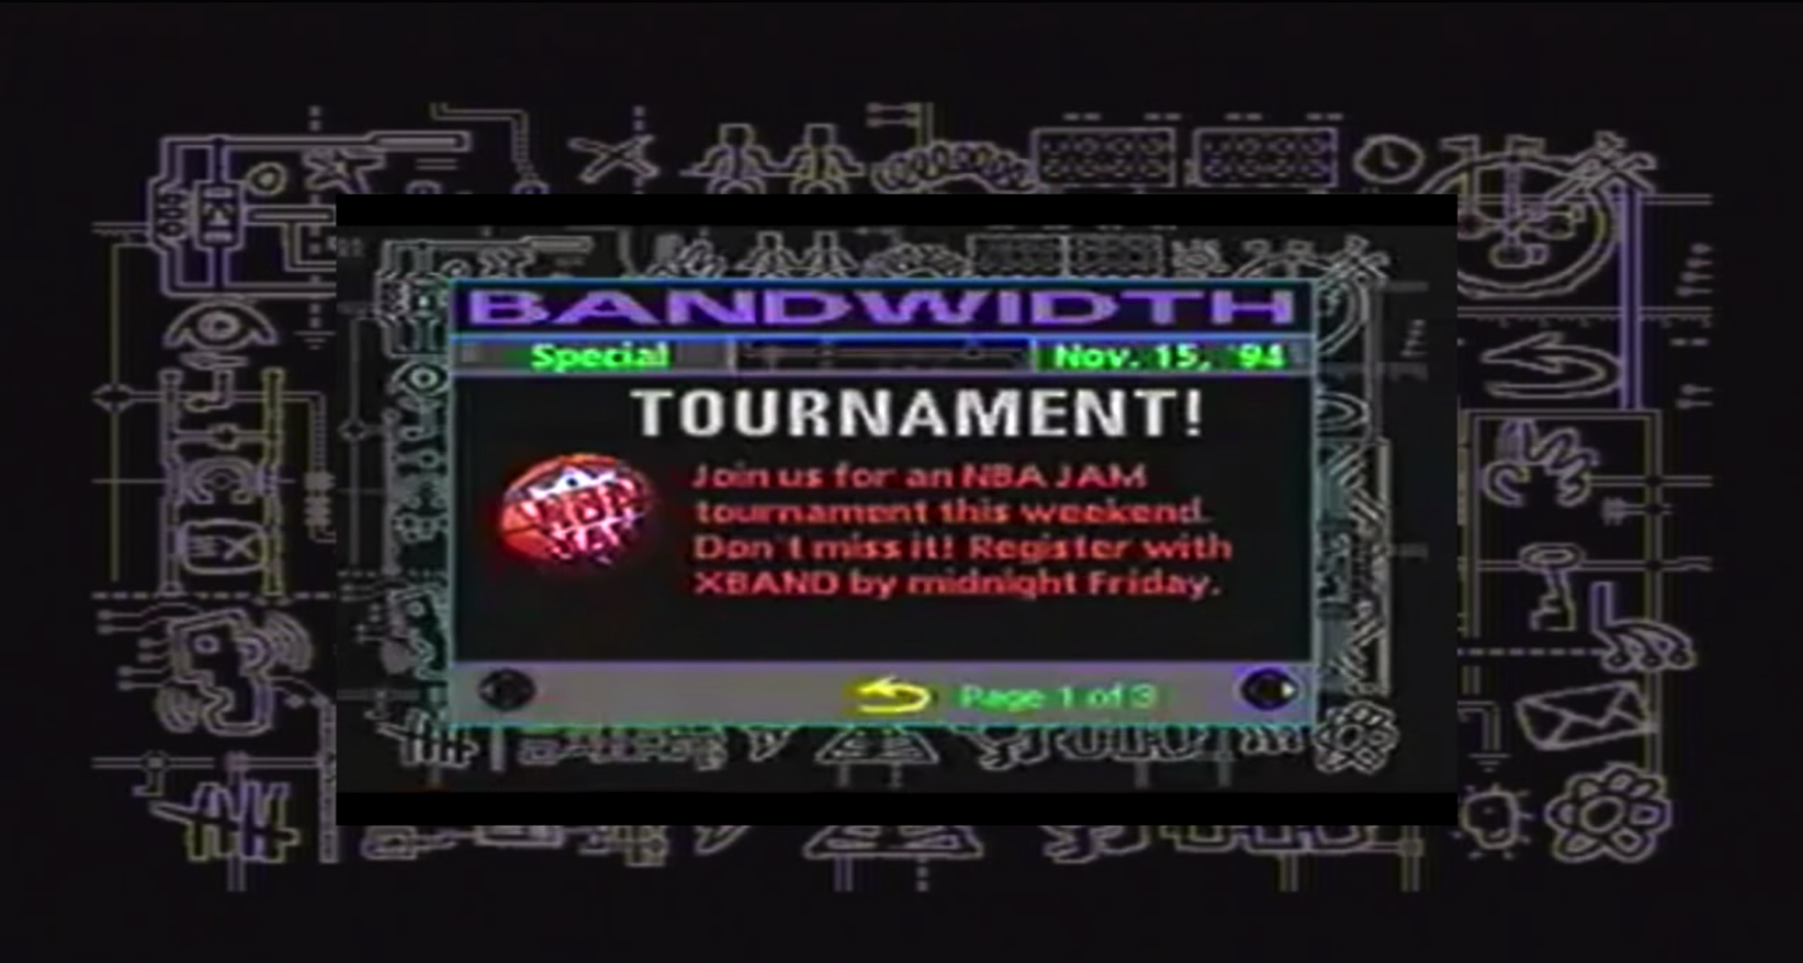

Slide 17
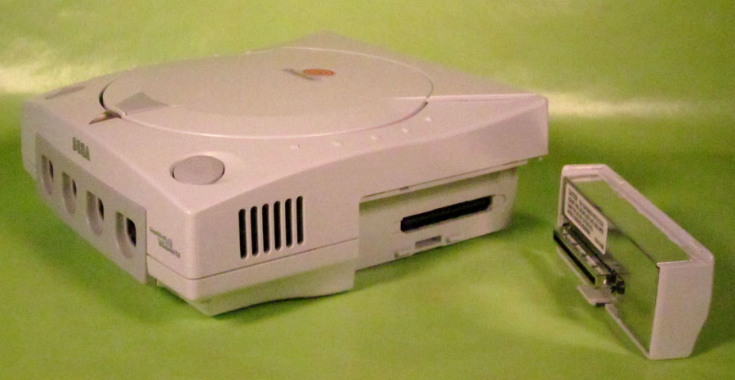

Slide 18
